Slide 1
GiT

Slide 2
Introduction
Git is a distributed revision control and source code management system with an emphasis on speed. Git was initially designed and developed by Linus Torvalds for Linux kernel development. Git is a free software distributed under the terms of the GNU General Public License version 2.
Git is an open-source, version control tool created in 2005 by developers working on the Linux operating system; GitHub is a company founded in 2008 that makes tools which integrate with git.
You do not need GitHub to use git, but you cannot use GitHub without using git. There are many other alternatives to GitHub, such as GitLab, BitBucket, and “host-your-own” solutions such as gogs and gittea.

Slide 3
Version Control System
Version Control System (VCS) is a software that helps software developers to work together and maintain a complete history of their work.
Listed below are the functions of a VCS −
Allows developers to work simultaneously.
Does not allow overwriting each other’s changes.
Maintains a history of every version.
Following are the types of VCS −
Local version control system
Centralized version control system (CVCS).
Distributed/Decentralized version control system (DVCS).

Slide 4
Advantages of Git
Free and open source
Git is released under GPL’s open source license. It is available freely over the internet.
Fast and small
Git does not rely on the central server; that is why, there is no need to interact with the remote server for every operation. The core part of Git is written in C, which avoids runtime overheads associated with other high-level languages. Though Git mirrors entire repository, the size of the data on the client side is small. This illustrates the efficiency of Git at compressing and storing data on the client side.
Implicit backup
The chances of losing data are very rare when there are multiple copies of it. Data present on any client side mirrors the repository, hence it can be used in the event of a crash or disk corruption.
Security
Git uses a common cryptographic hash function called secure hash function (SHA1), to name and identify objects within its database. Every file and commit is check-summed and retrieved by its checksum at the time of checkout. It implies that, it is impossible to change file, date, and commit message and any other data from the Git database without knowing Git.
No need of powerful hardware
In case of CVCS, the central server needs to be powerful enough to serve requests of the entire team. For smaller teams, it is not an issue, but as the team size grows, the hardware limitations of the server can be a performance bottleneck. In case of DVCS, developers don’t interact with the server unless they need to push or pull changes. All the heavy lifting happens on the client side, so the server hardware can be very simple indeed.
Easier branching
CVCS uses cheap copy mechanism, If we create a new branch, it will copy all the codes to the new branch, so it is time-consuming and not efficient. Also, deletion and merging of branches in CVCS is complicated and time-consuming. But branch management with Git is very simple. It takes only a few seconds to create, delete, and merge branches.

Slide 5
Install Git
Install Git on Mac OS X
$ git --version git version 2.7.0 (Apple Git-66)
Git for Mac Installer
The easiest way to install Git on a Mac is via the stand-alone installer:
Download the latest Git for Mac installer.
Follow the prompts to install Git.
Open a terminal and verify the installation was successful by typing
git --version
Configure your Git username and email using the following commands. These details will be associated with any commits that you create:
$ git config --global user.name “Neelam Singh“
$ git config --global user.email “neelamsingh@geu.ac.in"

Slide 6
Install Git on Windows
Download the latest Git for Windows installer.
When you've successfully started the installer, you should see the Git Setup wizard screen. Follow the Next and Finish prompts to complete the installation. The default options are pretty sensible for most users.
Open a Command Prompt (or Git Bash if during installation you elected not to use Git from the Windows Command Prompt).
Run the following commands to configure your Git username and email using the following commands, replacing Emma's name with your own. These details will be associated with any commits that you create:
$ git config --global user.name " Neelam Singh " $ git config --global user.email “neelamsingh@geu.ac.in"

Slide 7
Install Git on Linux
Debian / Ubuntu (apt-get)
Git packages are available via apt:
From your shell, install Git using apt-get:
$ sudo apt-get update
$ sudo apt-get install git
Verify the installation was successful by typing
$ git –version
Configure your Git username and email using the following commands
$ git config --global user.name “Neelam Singh“
$ git config --global user.email “neelamsingh@geu.ac.in"

Slide 8
Fedora (dnf/yum)
Git packages are available via both yum and dnf:
From your shell, install Git using dnf (or yum, on older versions of Fedora):
$ sudo dnf install git
$ sudo yum install git
Verify the installation was successful by typing.
Configure your Git username and email.

Slide 9
Customize Git Environment
Git provides the git config tool, which allows to set configuration variables. Git stores all global configurations in .gitconfig file, which is located in home directory. To set these configuration values as global, add the --global option, and if --global option is omitted, then the configurations are specific for the current Git repository.

Slide 10
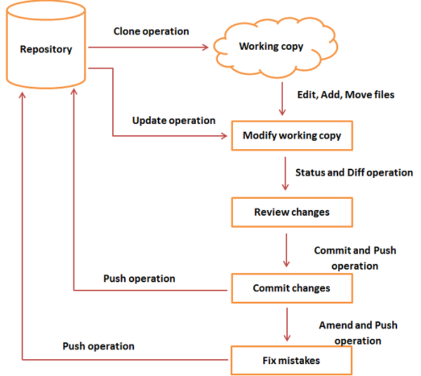
Git - Life Cycle
General workflow is as follows −
Clone the Git repository as a working copy.
Modify the working copy by adding/editing files.
If necessary, update the working copy by taking other developer's changes.
Review the changes before commit.
Commit changes. If everything is fine, then push the changes to the repository.
After committing, if something is wrong, then correct the last commit and push the changes to the repository.

Slide 11
Git Tools
Git comes with some of its tools like Git Bash, Git GUI to provide the interface between machine and user. It supports inbuilt as well as third-party tools.
Git comes with built-in GUI tools like git bash, git-gui, and gitk for committing and browsing. It also supports several third-party tools for users looking for platform-specific experience.
Git Package Tools
Git provides powerful functionality to explore it. We need many tools such as commands, command line, Git GUI. Let's understand some essential package tools.
GitBash
Git Bash is an application for the Windows environment. It is used as Git command line for windows. Git Bash provides an emulation layer for a Git command-line experience. Bash is an abbreviation of Bourne Again Shell. Git package installer contains Bash, bash utilities, and Git on a Windows operating system.
Bash is a standard default shell on Linux and macOS. A shell is a terminal application which is used to create an interface with an operating system through commands.

Slide 12
Git Bash Commands
Git Bash Commands
Git Bash comes with some additional commands that are stored in the /usr/bin directory of the Git Bash emulation. Git Bash can provide a robust shell experience on Windows. Git Bash comes with some essential shell commands like Ssh, scp, cat, find.
Git Bash also includes the full set of Git core commands like git clone, git commit, git checkout, git push, and more.

Slide 13
Git GUI
Git GUI is a powerful alternative to Git BASH. It offers a graphical version of the Git command line function, as well as comprehensive visual diff tools. We can access it by simply right click on a folder or location in windows explorer. Also, we can access it through the command line by typing below command.
$ git gui

Slide 14
Gitk
gitk is a graphical history viewer tool. It's a robust GUI shell over git log and git grep. This tool is used to find something that happened in the past or visualize your project's history.
Gitk can invoke from the command-line. Just change directory into a Git repository, and type:
$ gitk [git log options]

Slide 15
Git Terminology
Branch
A branch is a version of the repository that diverges from the main working project. It is an essential feature available in most modern version control systems. A Git project can have more than one branch. We can perform many operations on Git branch-like rename, list, delete, etc.
Checkout
In Git, the term checkout is used for the act of switching between different versions of a target entity. The git checkout command is used to switch between branches in a repository.
Cherry-Picking
Cherry-picking in Git is meant to apply some commit from one branch into another branch. In case you made a mistake and committed a change into the wrong branch, but do not want to merge the whole branch. You can revert the commit and cherry-pick it on another branch.
Clone
The git clone is a Git command-line utility. It is used to make a copy of the target repository or clone it. If I want a local copy of my repository from GitHub, this tool allows creating a local copy of that repository on your local directory from the repository URL.
Fetch
It is used to fetch branches and tags from one or more other repositories, along with the objects necessary to complete their histories. It updates the remote-tracking branches.
HEAD
HEAD is the representation of the last commit in the current checkout branch. We can think of the head like a current branch. When you switch branches with git checkout, the HEAD revision changes, and points the new branch.
Index
The Git index is a staging area between the working directory and repository. It is used as the index to build up a set of changes that you want to commit together.

Slide 16
Master
Master is a naming convention for Git branch. It's a default branch of Git. After cloning a project from a remote server, the resulting local repository contains only a single local branch. This branch is called a "master" branch. It means that "master" is a repository's "default" branch.
Merge
Merging is a process to put a forked history back together. The git merge command facilitates you to take the data created by git branch and integrate them into a single branch.
Origin
In Git, "origin" is a reference to the remote repository from a project was initially cloned. More precisely, it is used instead of that original repository URL to make referencing much easier.
Pull/Pull Request
The term Pull is used to receive data from GitHub. It fetches and merges changes on the remote server to your working directory. The git pull command is used to make a Git pull.
Pull requests are a process for a developer to notify team members that they have completed a feature. Once their feature branch is ready, the developer files a pull request via their remote server account. Pull request announces all the team members that they need to review the code and merge it into the master branch.
Push
The push term refers to upload local repository content to a remote repository. Pushing is an act of transfer commits from your local repository to a remote repository. Pushing is capable of overwriting changes; caution should be taken when pushing.
Rebase
In Git, the term rebase is referred to as the process of moving or combining a sequence of commits to a new base commit. Rebasing is very beneficial and visualized the process in the environment of a feature branching workflow.

Slide 17
Git Commands
1) Git config command
This command configures the user. The Git config command is the first and necessary command used on the Git command line. This command sets the author name and email address to be used with your commits.
$ git config --global user.name “name"
$ git config --global user.email email@gmail.com
2)Git Init command
This command is used to create a local repository.
The init command will initialize an empty repository.
$ git init Demo
3) Git clone command
This command is used to make a copy of a repository from an existing URL. If I want a local copy of my repository from GitHub, this command allows creating a local copy of that repository on your local directory from the repository URL.
$ git clone URL

Slide 18
4) Git add command
This command is used to add one or more files to staging (Index) area.
Syntax
To add one file
$ git add Filename
To add more than one file
$ git add*
5) Git commit command
Commit command is used in two scenarios. They are as follows.
git commit –m
This command changes the head. It records or snapshots the file permanently in the version history with a message.
$ git commit -m " Commit Message"

Slide 19
Git Workflow
A Git workflow is a recipe or recommendation for how to use Git to accomplish work in a consistent and productive manner. Git workflows encourage developers and DevOps teams to leverage Git effectively and consistently. Git offers a lot of flexibility in how users manage changes.
Types
Centralized Git workflow
Feature branching Git workflow
Trunk-based development Git workflow
Personal branching Git workflow
Forking Git workflow
GitFlow Git workflow

Slide 20
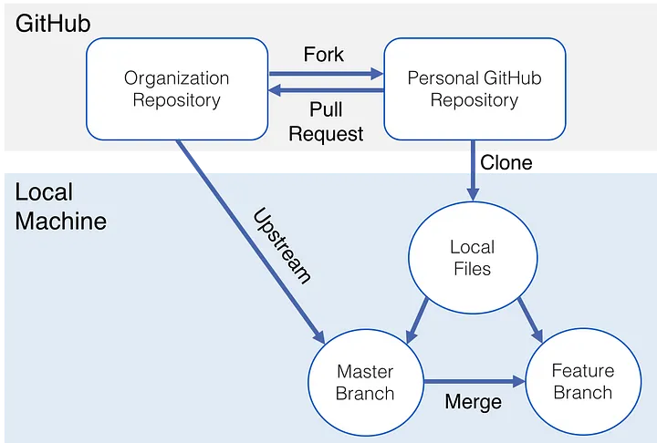

Slide 21
Centralized Git workflow
A centralized Git workflow enables all team members to make changes directly to the main branch (sometimes called the master branch or default branch), with every change logged in a running history. A centralized workflow involves every contributor committing to the main branch without using any other branch.
What is the benefit of a centralized Git workflow?
After developers apply a stash and solve any merge conflicts, they can just commit as usual without dealing with automatic merge commits, unless someone pushed their changes at the same time. Because this strategy is simple, it is well-suited for small teams, Git beginners, and projects that don’t get a lot of updates.
Feature branching Git workflow
Every feature gets its own branch when developers commit to this workflow. Rather than commit directly to the main branch, developers create a branch, make changes, submit a merge request (or pull request), and then merge it into main.
What is the benefit of a feature branching Git workflow?
This Git workflow has the benefit of keeping a clean main branch that isn’t polluted with unfinished features. Teams of any size can use this feature branching, because it permits multiple developers to work on the same feature simultaneously. Software that’s still in development sees the most benefit from feature branching, but this workflow can be used for more mature applications as well.

Slide 22
Trunk-based development Git workflow
Trunk-based development facilitates concurrent development on a single branch called trunk. When developers are ready to push changes to the central repository, they’ll pull and rebase from it to update the working copy of the central branch. Successful trunk-based development requires a developer to resolve merge conflicts locally. Regularly updating the local branch reduces the impact of integration changes, because they’re spotted when they’re still small, avoiding merge hell.
What is the benefit of trunk-based development Git workflow?
Trunk-based development decreases the likelihood of merge conflicts and keeps code clean, because there are many frequent, small merges made each day. With continuous integration, a trunk-based workflow ensures fast feedback and a team-oriented approach to code ownership and development.

Slide 23
Personal branching Git workflow
Personal branching is similar to feature branching, but rather than have a single branch per feature, it’s per developer. This approach works well if team members work on different features and bugs. Every user can merge back to the main branch whenever their work is done.
What is the benefit of personal branching Git workflow?
Personal branching has similar advantages as feature branching, and also benefits from having fewer branches, so branch management is easier. Personal branches can be used for bug fixes and other small changes, and they help developers innovate if they’re interested in experimenting. Personal branching is useful for long-running features that may not fit into a single release cycle. This strategy can work well for small teams in which every team member develops their own part of the application.

Slide 24
Forking Git workflow
A forking approach to version control starts with a complete copy of the repository. Forking effectively creates a local copy of a Git repository and provides the ability to create a new collaboration structure. In other words, every developer in the team has two repositories: a local workspace and a remote repository.
This workflow is popular for projects that have multiple developers contributing to it, particularly open source projects. After all, keeping track and providing privileges to collaborate to a repository with thousands of contributors is difficult to maintain. If a maintainer enables contributors to try their changes on their forked copy, managing change proposals is easier and safer.
What is the benefit of a forking Git workflow?
With a forking workflow, contributors can push changes to a server-side repository, decreasing the likelihood of including low-quality code and bugs into the source code. Only a project maintainer can integrate changes to the source code. When large teams collaborate on software development projects, forking enables secure, quality-driven development.

Slide 25
GitFlow Git workflow
With GitFlow, the main branch should always be releasable to production, and there should never be untested or incomplete code on the main branch. When using this Git workflow, no one commits to the main branch but rather uses a develop branch with feature branches. When the develop branch is ready to go to production, a contributor creates a release branch where testing and bug fixing occur before being merged back to the develop branch. The release branch makes the code review process easier, because there’s a dedicated place to resolve conflicts when merging into the main branch. With this strategy, the main branch always reflects production.
What is the benefit of a GitFlow Git workflow?
The benefit of GitFlow as a Git production workflow is that it allows larger teams to work on complex software while still being able to quickly fix bugs in production. In addition, the release branch allows for a staging period where users can test the software in a staging environment before it’s released, which doesn’t hinder code development. Teams of any size can use GitFlow, but smaller teams may find one of the other strategies easier to use due to its complexity. When dealing with multiple environments and regular deployments, GitFlow may offer the workflow flexibility some teams require.

Slide 26
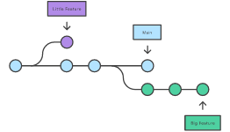
Branching and Merging in Git.
Branching is a feature available in most modern version control systems. Branching in other VCS's can be an expensive operation in both time and disk space.
In Git, branches are a part of your everyday development process. Git branches are effectively a pointer to a snapshot of your changes. When you want to add a new feature or fix a bug—no matter how big or how small—you spawn a new branch to encapsulate your changes. This makes it harder for unstable code to get merged into the main code base, and it gives you the chance to clean up your future's history before merging it into the main branch.

Slide 27
Steps
Step 1: Set up a Github Organization
This will be the core code of your project. It is the central working repository on Github that everyone will draw from.
Step 2: Fork Organization Repository to Your Personal GitHub
Next fork the central organization repository to your personal GitHub account. This will be your own copy of the project files.
Step 3: Clone the Repository to Your Local Machine
Next, create a local copy of these files on your personal machine so you can modify/add to them. You do this by navigating to the directory where you wish to store the project and typing the following into the command line (excluding the ‘<’ and ‘>’ symbols):
git clone <url to the project repo on your personal Github profile>
*Be sure the url ends with .git
This ‘clones’ your GitHub repo to your personal computer. Afterwards, navigate into the cloned directory your just created. Now type:
git branch

Slide 28
Step 4: Create a Branch for your Working Files
But what if you want to update the project? Where should you make your changes if the master branch can only have clean, functional code? Let’s make a new branch to create new features, test things out and essentially be the working file. You create a new branch (and move into it) by typing:
git checkout -b <branch name>
The -b is important, that is what is creating the new branch. I will be calling this branch that contains our working files ‘feature’ from here on out, but you can call it whatever you like.
Step 5: Set Remote Repository to the GitHub Organization
As you continue to work on your project, you will periodically want to incorporate changes from your other team members. Since your GitHub organization is where your functional code is stored, you will want to pull from there. In order to set up this link between your local directory on your own machine and the GitHub organization repository, you will need to set up a ‘remote’ repository (aka a repo that is remote and not located on your local machine). Do this by typing:
git remote add upstream <url to the organization on GitHub>
‘Upstream’ is the conventional name chosen for a remote, but it can be anything you like.
Step 6: Get Coding!
Add those new features, tests, and tweaks (you’re making these changes on the feature branch, right?). Once you get to a place where you feel good about the work you’ve done, let’s incorporate it into the project’s code base
Step 7: Pull the Most Recent Files From the Organization Repo
All the steps from here on out are to ensure a clean incorporation of your code into the project’s code base. The goal is to isolate any potential code conflicts by adding safeguards to ensure the project’s code is not harmed by anyone’s contribution.

